Slide 1
Topic: Environmental Health
Sub-topic: Effects of Global Warming on Environmental Health
Name
Institution
Date

Slide 2
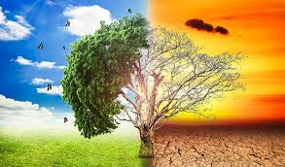
Introduction
The environment is all that is around us, include the biotic factors and the abiotic factors.
The natural factors in geographical areas determine human activities.
The selected topic for this presentation is global warming (Sharma & Gahlawat, 2017).
Global warming is the gradual increase in the Earth's temperature, thus initiating climatic changes.
Environmental factors interfere with human health
Notes:
The environment is all that is around us, ranging from biotic factors like plants and other animals, as well as abiotic factors like water and soil (Sharma, & Gahlawat, 2017). The nature of the environment determines the kind of human activities to be practiced in that particular area. This selected topic in this presentation is global warming that is understood as the increase in the temperature of the Earth due to greenhouse effects. This then leads to climatic changes, and the environmental conditions can end up interfering with human health.

Slide 3
The Purpose of this presentation
To explain the causes of global warming
To examine both general and health effects causes by global warming
Offer a comprehensive coverage of the infections caused by global warming
To provide mitigation factors for controlling both global warmings and at the same time improving health
Notes:
A good research paper offers an effective explanation of when it is dealing with. This keeps the paper organized and lead to the realization of the intended goals. Concerning the global warming controversy, there is a need for the public to be enlightened on its causes, examine the health care effects of global warming and give sufficient data on the persistence of the infections as a result of poor health (Canas & Munkhbat, 2019). The most significant thing is to solve problems identified in the research and thus the need to offer mitigation strategies for global warming and thus promoting good health among humans.

Slide 4
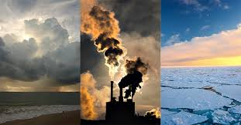
Causes of Global Warming
Human activities ate leading the leading causes of global warming
Combustion of fossil fuels
Deforestation
Overgrazing
The mining industries
Production activities
Other than the human activities, volcanic activities also cause global warming
Notes:
It is indisputable that humans are harming themselves based on the activities they do. The conduction of activities that produce greenhouse gases like carbon dioxide, methane, and nitrous oxide case initiate global warming. Think of the combustion of fossil fuels. All the care across the globe use fuels, and these fuels are combusted to produce greenhouse gases into the atmosphere (Sharma, & Gahlawat, 2017). Cutting down trees, which are the primary consumers of excessive carbon dioxide, leads to the accumulation of the gas into a higher amount. The production activities in the industries are also among the leading producers of pollution. However, some people have launched a counterclaim that volcanic activities produce greenhouse gases, which is true, but human activities are the leading.

Slide 5
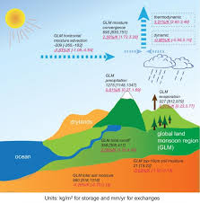
General Effects of Global Warming
Climatic change
Rising sea levels which lead to flooding on the sea shows
Disruption of habitats for many living organisms (Sharma, & Gahlawat, 2017).
The forests, farms, and cities face trouble in new pest, heatwaves, and healthy rains
Unpredictable weather patterns and thus increasing the risks of harm on humans
Notes:
Scientists agree that the Earth's rising temperatures are fueling longer and hotter heat waves, more frequent droughts, heavier rainfall, and more powerful hurricanes. They also said the odds of similar droughts happening in the future had roughly doubled over the past century. And in 2016, the National Academies of Science, Engineering, and Medicine announced that it's now possible to confidently attribute certain weather events, like some heat waves, directly to climate change. As well there have been rising sea levels will lead to coastal flooding on the Eastern Seaboard, especially in Florida, and in other areas such as the Gulf of Mexico. Forests, farms, and cities will face troublesome new pests, heat waves, heavy downpours, and increased flooding. All those factors will damage or destroy agriculture and fisheries. Lastly, Disruption of habitats such as coral reefs and Alpine meadows could drive many plant and animal species to extinction.

Slide 6
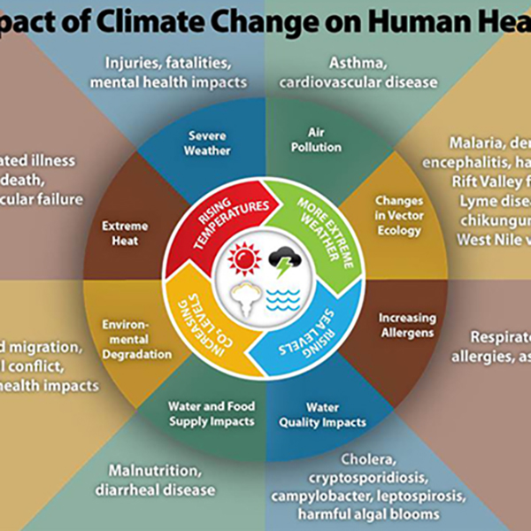
The Health Effects of Global Warming
Currently, the rate of infection on humans has been on the increase, and global warming is the primary reason. The infections caused include:
  Asthma
  Allergies
  Malaria
  Lung diseases
  Cholera
  Dengue fever
  Skin cancer
Notes:
Scientists have agreed on the fact that human is the most affected by the reparations of global warming. Think of the cases of Allergies and other asthmatic conditions across the globe. Since the start of the industrial revolution, some infections have been turning dominant of the Earth, and this forces us to live with some disease. Other respiratory infections caused by the effects of global warming include lung infections (Bein, Karagiannidis, & Quintel, 2019). People suffering from heart problems are more vulnerable to increased temperatures, especially those living in already warm areas, as their cardiovascular system must work harder to keep their bodies cool. Hot temperatures increase the ozone concentration, which can damage people's lung tissue and cause complications for asthma patients and those with lung diseases. The incidences of Malaria have been on the increase, especially in the tropic of Africa due to a favoring environment for the breeding of mosquitoes. This infection has been claiming the lives of many children and expectant mothers mostly.

Slide 7
Statistics On Global Warming Related Infections
The cases of Malaria reported in the entire world are not less than 228 million cases. The estimated number of malaria deaths in at least 405 000 and this is due to the bites from female Anopheles mosquitoes that breed in the stagnant waters (Bein, Karagiannidis, & Quintel, 2019).
It is estimated that there will be around 300 million people have Asthma worldwide, and it is likely that by 2025 a further 100 million may be affected. There is a significant geographical variation in asthma prevalence, severity, and mortality, and global warming cannot be argued out of this infection (Bein, Karagiannidis, & Quintel, 2019).
Respiratory infections are the leading causes of death among the human population. With time there has been the outbreak of lung infections like COPD, and the current Covid-19 raises significant concerns on the relation between the diseases and global warming effects, and this controversy needs to be solved.
Notes:
The mosquitoes are the most common vectors for infection. One of the diseases that has been caused by mosquitoes is Malaria. The cases of Malaria reported in the entire world are not less than 228 million cases (Bein, Karagiannidis, & Quintel, 2019). The estimated number of malaria deaths in at least 405 000 and this is due to the bites from female Anopheles mosquitoes that breed in the stagnant waters. The mosquitoes as well cause dengue fever. Asthma is another infection that is gaining prevalent across the human population, and researches have suggested that if changes do not happen on the mitigation programs for the disease, over 300 million people will suffer the infection by 2025. An existing controversy is whether there is any relation between covid-19 and climatic changes. Whether true or not, greenhouse gas emissions need to be regulated.

Slide 8
A Table On the Infections Due To Global Warming
Infection | Pathway effects | Environmental changes | Cases reported in 2019
Malaria | Female Anopheles mosquito as vector | Increased breeding sites for mosquitoes | 228 million new infections and at least 400,000 deaths.
Asthma | Exposure to allergens | Increased air pollution which causes allergens. | 19.2 million cases and at least 600 deaths (Rossati, 2017).
Cholera | Sanitation, hygiene and water containment | Flooding due to excessive rains. | There were 299,687 new cases and at least 3,000 fatalities
Dengue fever | Mosquito breeding sites and water collecting trash | Increased water stagnation due to flooding. | 2.7 million new case and over 1200 fatalities (Rossati, 2017).
Skin cancer | Scorching effect of the sun | Weakening of ozone layer | It is estimated that 192,310 new cases of melanoma were reported in 2019
Notes:
The table above can be analyzed that the most killer infection due to global warming effects is Malaria. Our interest is to understand the connection between global warming and Malaria. Increased rains make waters stagnate in the tropics of continents like Africa, and this creates breeding sites for mosquitoes, which are the man vector for malaria parasite. In the same way, the dengue infection has been caused by mosquitoes, and thus the impact of mosquitoes as vectors has been felt. Flooding leads to contamination of water, and this attracts cholera, which kills people within a short time if no medical intervention is offered. Exposure to allergens like greenhouse gases stimulates an allergic reaction, which causes Asthma. Generally, air pollution causes Asthma. According to Rossati, (2017), the other disease is skin cancer resulting from the carcinogenic substances from the sun rays which easily penetrate the skin due to the reduced effect of the ozone layer in controlling the sun rays. Cancer is a killer disease that is very much hard to cure as well as prevent it since it is categorized as a lifestyle disease, making it a complicated situation to avoid.

Slide 9
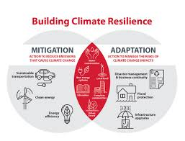
Mitigation for Global Warming
There is a need to offer sustainable transportation
Offering public education on the need to prevent global warming
The research organizations concerned with global warming should be given financial support
Sustainable agriculture and forest management by encouraging better use of natural resources, stopping massive deforestation, and making it more efficient
Renewable energy sources can be used to replace fossil fuels (Li, 2019).
Limiting deforestation and planting more trees
Passing policies that overlook the emission of greenhouse gases
Notes:
The impacts of global warming can be reduced. The effect of global warming is intense and can be reduced. As stated by Li (2019), renewable energies can be used to replace fossil fuels. These renewable energies are safer and include solar, wind, biomass, and geothermal. Moreover, energy and water efficiency like creating clean energy but reducing the consumption of energy and water by use of more efficient devices like innovative shower systems when they are less costly than the commonly used. As well, sustainable agriculture and forest management by encouraging better use of natural resources, stopping massive deforestation, and making it more efficient. In the process of preventing deforestation, people should also focus on reforestation (Jacobson, 2019). This action will lead to increased number of tree to absorb the excessive carbon dioxide that is the common greenhouse gas. The responsible consumption and recycling by adopting good consumptions habits crucial on food, clothing, cosmetics, or cleaning products. More significantly, public education can help in solving the problems of global warming since the public is already made aware on its causes as well as the possible means of reducing the intensification of this problem. The research organizations concerned with global warming should be given financial support since the main issue affecting this organization is the shortage of finances (Jacobson, 2019). With enough financial resources, the organization will be able to come up with practical resolutions to global warming issues. Lastly, there is a need to offer sustainable transportation, which will help in limiting the need for using carbon dioxide emissions and thus fight global warming.

Slide 10
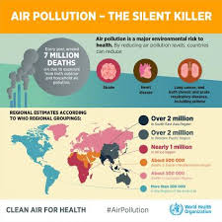
Strategies To Minimize the Infections Due To Global Warming
For malarial and dengue infection:
Applying mosquito's repellent on the skin surface
Sleeping under treated mosquito net
Keeping the environment clean by eliminating the mosquito breeding sites
For cholera, it is advisable to maintain hygiene and eat clean foods (Li, 2019).
Asthma can be controlled by avoiding the allergens if possible.
Skin cancer is controlled by preventing sunburn, especially on hot days.
Notes:
The fact that we have already initiated the global warming effects means that we need to find mechanisms of adapting to the changes and this is by preventing further infections. For the case of malaria and dengue infection, draining all the stagnant water and limiting the breeding sites for mosquitoes will help in managing the affairs. As well, use of mosquito repellent and sleeping under treated mosquito nets (Canas & Munkhbat, 2019). Avoiding allergens is thought to be the most effective strategy for curbing the spread of Asthma. Skin cancer is well managed by avoiding direct sunburns. General hygiene helps in preventing the spread of cholera.

Slide 11
Summary
Human activities are the primary causes of global warming on the Earth
Humans suffer the most due to the greenhouse effects, and thus managing global warming may lead to healthy lives (Canas & Munkhbat, 2019).
The analysis of statistics has shown that many infections have become dominant due to climatic changes
The unpredictable weather patterns are having a more significant impact on the environmental health
Managing global warming will be costly for the entire universe, but the results will lead to improved health
Notes:
The impacts of human activities on global warming are indisputable. If it were not for fuel combustion activities, it would have been easy to manage the natural causes of global warming. For a very long time, nature has had its ways of balancing itself. The pressures from human activities surpass the amount the natural forces can control and thus causing impacting on human health. The primary concern of environmental health is to understand the better means of managing the environmental factors and therefore keep humans healthy. Global warming is almost running out of human control since people are much concerned about making finances rather than preserving the environment. In this case, humans are enemies to their health.

Slide 12
References
Bein, T., Karagiannidis, C., & Quintel, M. (2019). Climate change, global warming, and intensive care. Intensive Care Medicine, 1-3.
Canas, J., & Munkhbat, Y. (2019). Design to Combat the Effects of Greenhouse Gases and Pollution.
Jacobson, M. Z. (2019). Evaluation of Nuclear Power as a Proposed Solution to Global Warming, Air Pollution, and Energy Security.
Li, Z. (2019). Global Warming: Causes and Effects. Routledge.
Rossati, A. (2017). Global warming and its health impact. The international journal of occupational and environmental medicine, 8(1), 7.
Sharma, V., & Gahlawat, I. N. (2017, November). Global warming: Causes and Effects. In Proceedings of National Conference (pp. 71-74).

